Slide 1
Predicting Creditworthiness Using Machine Learning
Team Name: Debug Divas
A Data-Driven Approach to Informed Lending Decisions
Date: 18 October 2024
Presented by: Jatin Joshi
Khushi Modi
Arya Jain
Toshak Sharma

Slide 2


Creditworthiness Assessment in Banking
The banking industry faces significant risks when lending loans to customers.
Accurate assessment of creditworthiness is crucial for minimizing defaults.
This leads to customer churn.
Customer churn refers to the phenomenon of customers stopping doing business with a company over a certain period of time.
Impact on businesses:
Loss of Revenue
Increased Customer Acquisition Costs
Reduced Customer Lifetime Value
Damage to Brand Reputation

Slide 3
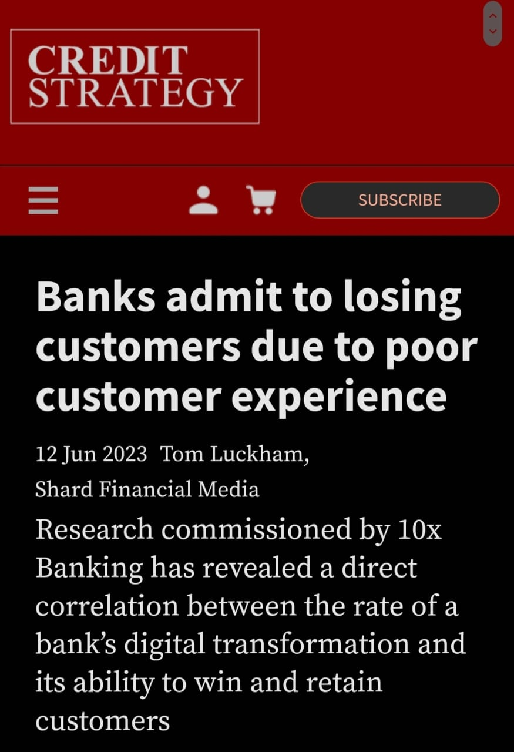
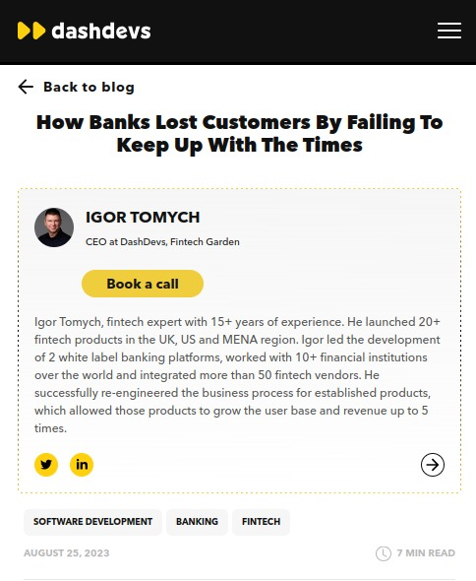
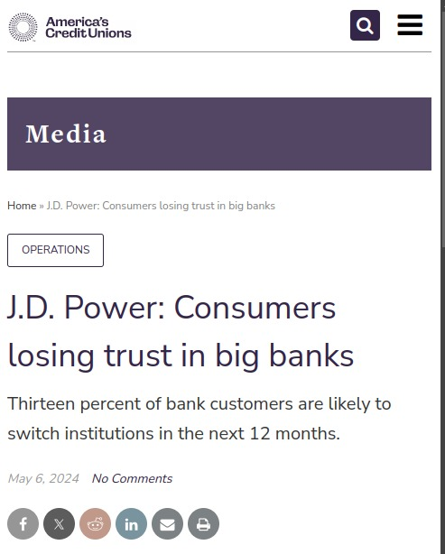

Slide 4
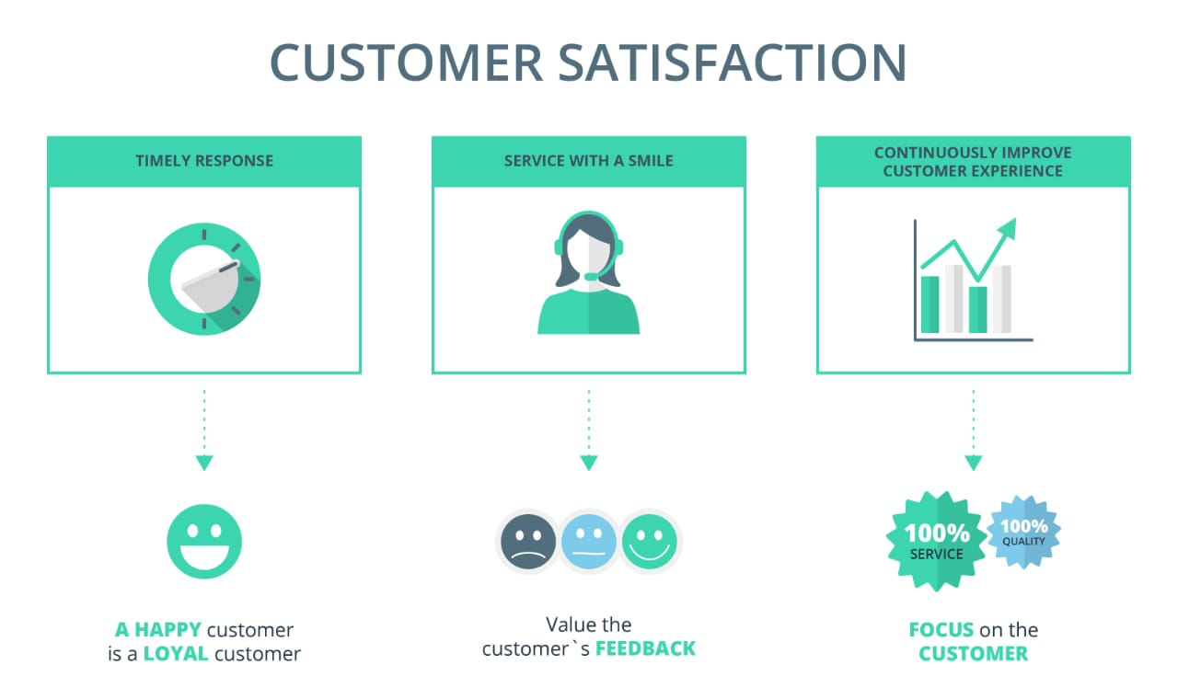
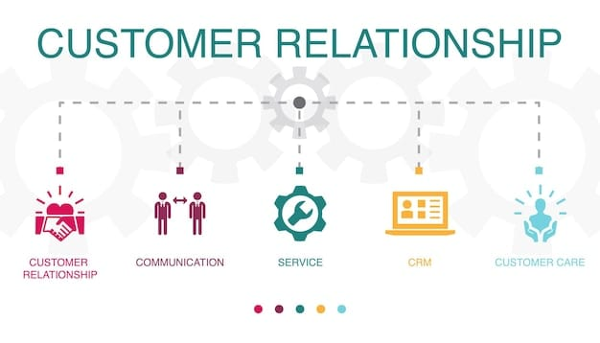
Why Customer churn Matters?
Customer churn matters because it can have a significant impact on a company's bottom line.
By understanding the reasons behind customer churn, businesses can develop strategies to reduce it and improve customer retention.
This can lead to increased revenue, improved customer satisfaction, and a stronger brand reputation.

Slide 5
The Importance of Predicting Churn
Profit Increase:
Retaining existing customers can boost profits by 25% to 95%.
Customer Experience:
Companies excelling at customer experience enjoy a 1.5x lower churn rate compared to competitors.
Strategic Advantage:
Proactive churn prediction allows businesses to implement targeted retention strategies, enhancing overall competitiveness.

Slide 6

Problem Statement: Predicting Customer Churns using Machine Learning
Key Question: How can we develop a machine learning model that accurately predicts the creditworthiness of bank customers?

Slide 7

Machine Learning Approach
The random forest algorithm is an ensemble learning method that combines multiple decision trees to improve the accuracy and robustness of predictions.

Slide 8
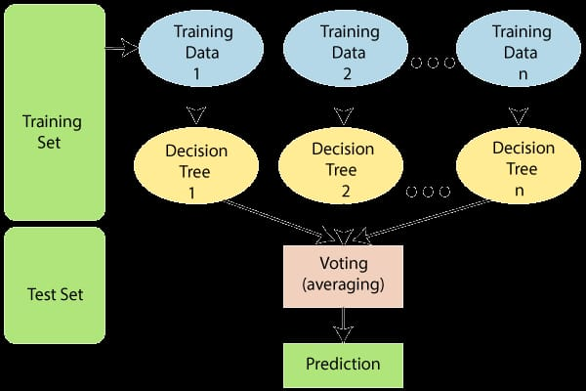

Slide 9
Why Random Forest
Improved Accuracy and Generalization
Robustness to Outliers and Noisy Data
Handling High-Dimensional Data
Handling Imbalanced Datasets
Scalability and Efficiency
Flexibility and Customizability
Algorithm | Accuracy | Robustness | Interpretability
Random Forest | High | High | High
Logistic Regression | Medium | Medium | Low
Decision Trees | Medium | Medium | Medium

Slide 10
Evaluation metrics
1. Accuracy
Definition: Accuracy measures the proportion of correct predictions (both true positives and true negatives) out of the total predictions made.
2. Precision
Definition: Precision measures the proportion of true positive predictions out of all positive predictions made by the model.
3. Recall (Sensitivity)
Definition: Recall measures the proportion of true positive predictions out of all actual positive cases. It indicates how well the model identifies positive cases.
4. F1 Score
Definition: The F1 Score is the harmonic mean of precision and recall. It provides a balance between the two metrics, especially when dealing with imbalanced datasets.

Slide 11
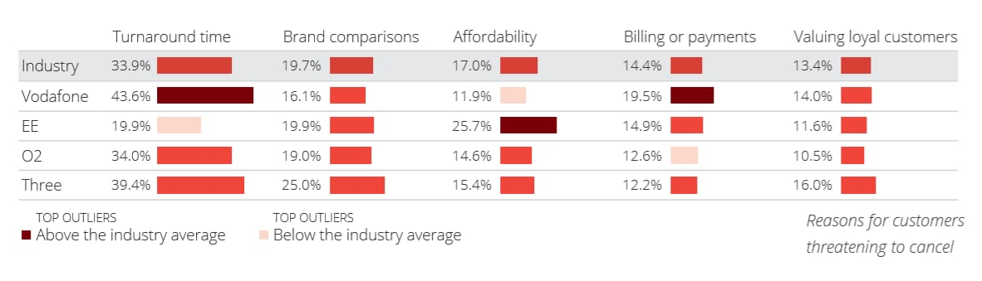
CASE STUDIES
Vodafone:
Vodafone has implemented machine learning-based churn prediction models to identify customers at risk of switching to a different service provider.
By analyzing customer behavior, such as call patterns, data usage, and billing information, Vodafone can proactively target these customers with personalized offers and promotions to retain their loyalty.

Slide 12
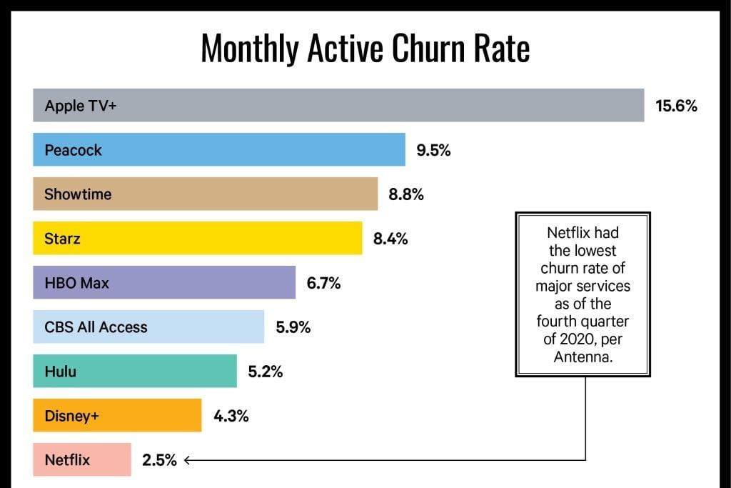
Netflix:
Netflix uses predictive analytics to keep subscribers engaged and reduce churn.
By analyzing user behavior, such as viewing history and search queries, Netflix can recommend personalized content to each user, increasing the likelihood that they will continue their subscription.

Slide 13
Random Forest Methodology for Predicting Churn
Data collection:
demographics, usage patterns, billing and payment history, customer support interactions, product/service usage metrics
Model training and validation:
split data, train random forest classifier, tune hyperparameters, evaluate performance
Key features influencing churn:
usage frequency and duration, billing and payment history, customer support interactions, product/service usage metrics, demographic characteristics

Slide 14
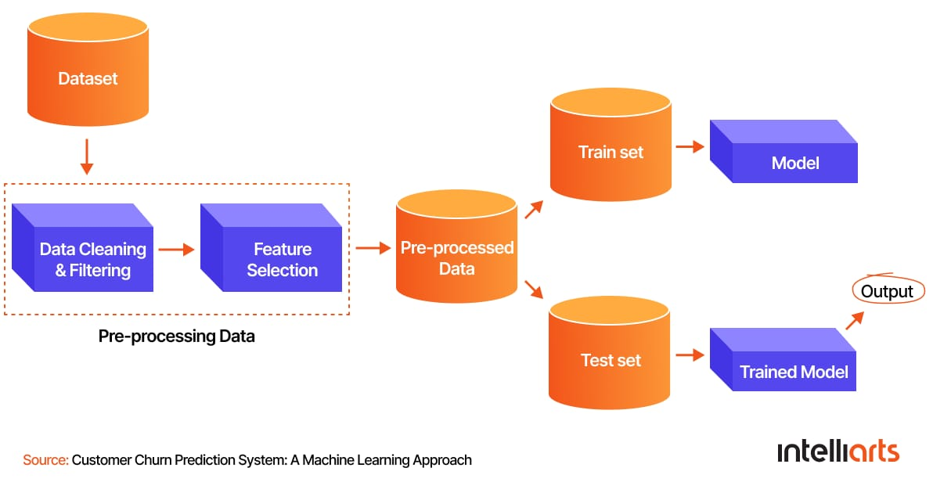

Slide 15

Current Trends in Customer Churn and Predictive Analytics
Focus on Customer Experience: Shift towards customer-centric strategies to enhance satisfaction and loyalty.
Personalization Demand: Rising need for tailored experiences based on individual customer data.
Investment in Customer Experience Tools: Expected to reach $14 billion by 2025, reflecting a strong commitment to enhancing customer engagement.
Cloud-Based Solutions: Increased use of cloud technologies for scalable and cost-effective predictive analytics.
Key Statistics:
80% of Companies: View customer experience as a key differentiator.
Projected Investment: $14 billion in customer experience tools by 2025.

Slide 16
Conclusion
This project addresses a critical need in the banking industry for accurate creditworthiness assessment.
We invite collaboration and feedback to enhance our approach and implementation.

Slide 17
THANK YOU!!!

